Slide 1


Reading at home with your child
Year 4

Slide 2

Find a comfortable, quiet place to read
Find somewhere in your home that you and your child feel comfortable
Try to make sure that your reading space is as quiet as possible, so your child can concentrate on their reading
Avoid distractions such as the television, as this will prevent your child from reading to their best

Slide 3

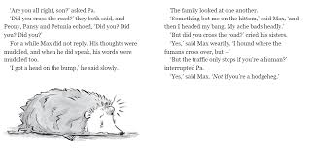
Walk through a new book with your child
If your child is reading a new book, give them time to explore the book a little before they start reading.
You can help them with this by…
Reading the title of the book together
Talking about the front cover
Looking at the pictures in the book
Picking out key words in the book which will help them read more fluently
If your child is continuing a book they’ve already started, recap on what they’ve read so far before continuing to read.

Slide 4

Ask your child to read the book aloud
Once you’ve walked through the book together/recapped on what’s happened so far, ask your child to read the book aloud.
Reading out loud is important to help your child read more fluently.
Your child doesn’t need to read a whole book every day. Concentrate on quality reading, rather than quantity.
Leave lots of time after reading aloud to ask questions about what’s been read!

Slide 5
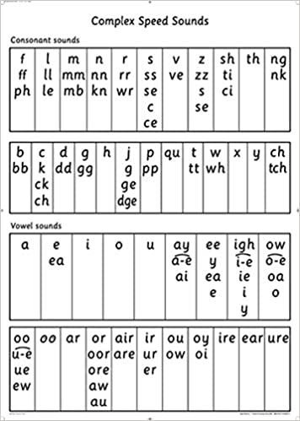

Helping your child to read tricky words
If your child gets stuck on a word, you could…
2. Ask them to miss out the word, read the rest of the sentence and see if they can work out what it means.
4. Revisit the word at the end of your reading session. Can your child remember what the word was?
1. Ask them to use their sounds (phonics)
3. Use picture clues to help
them

Slide 6

Talk about what you’ve read!
Talking about what’s been read is just as important as reading aloud.
A child who can read aloud but doesn’t understand what they’ve read will struggle to enjoy reading or see any purpose to it.
Ask your child to tell you what happened in the part of the book they just read and then ask them lots of questions about their book too!

Slide 7

Example questions you could ask:
Can you summarise what has happened so far in the book?
Who is your favourite character? Why?
What is your opinion on the book so far? Why?
What does the word ……. mean? How do you know?
What do you predict will happen next? Why?
Who are the main characters?
What would you do if you were this character? Why?
How do you think the character is feeling at the moment? Why?
Encourage your child to give evidence from the book to support their answers.

Slide 8
Reading skills
In school, Key Stage 2 children focus on eight reading skills…
Clarifying
Predicting
Inferring
Retrieval
Summarising
Asking questions
Making connections
Evaluating
Ask your child if they can use some of these skills to help them read aloud and to answer questions.

Slide 9

Use lots of praise
Encourage your child to enjoy reading by praising them.
You can help your child to improve their reading through praise too by saying things like…
“I really enjoyed listening to that sentence because you read it with lots of expression!”
“Well done for clarifying what that tricky word meant!”
“I love how you used a different strategy to read that word!”
“Excellent! You gave evidence to support your answer!”

Slide 10
Develop a love for reading with your child
Try to make reading part of family life by…
talking about books at any time of the day e.g. when walking home from school, whilst making meals
ask your child to share something they’ve read with another member of the family or family friend
look out for things to read wherever you are e.g. road signs, recipes, aisle names
let your child see you reading at home too!

Slide 11

Home Reading at
Preston Manor Lower School
Please read with your child for 15-20 minutes everyday.
The children should be reading their banded home reading books.
When you have read with your child, sign their reading record for your child’s teacher to see the next day.

Slide 12
Thank you for your continued support with your child’s reading!

